Slide 1

DISTRIBUTED SYSTEMS
HYBRID CENTRALIZED AND PEER-TO-PEER CHAT SYSTEM USING MPI
Presented by Group 12

Slide 2

ABOUT US
Lê Anh Tú
BA9-067
Lê Duy
BA9-075
Nguyễn Ngọc Khiêm
BA9-028
Nguyễn Văn Cường
BA9-011
Lý Anh Kiệt
BI10-092
Page 2

Slide 3

Introduction
Analysis
Design
Methods
Conclusion
CONTENTS
TOPIC 8: HYBRID CENTRALIZED AND PEER-TO-PEER CHAT SYSTEM USING MPI

Slide 4

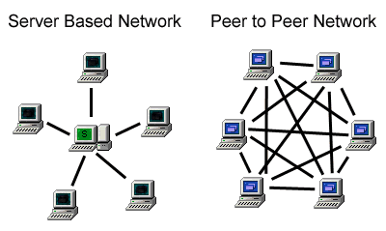
INTRODUCTION
-Peer-to-peer computing or networking is a distributed application architecture that partitions tasks or workloads between peers
WHAT IS P2P?

Slide 5
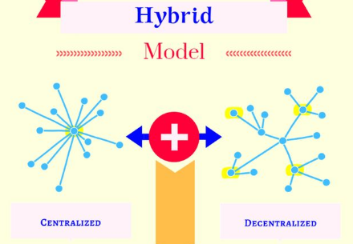
INTRODUCTION
-Peers search each other via a central server
- The central server maintains peers' information and connection
WHAT IS HYBRID CENTRALIZED?

Slide 6
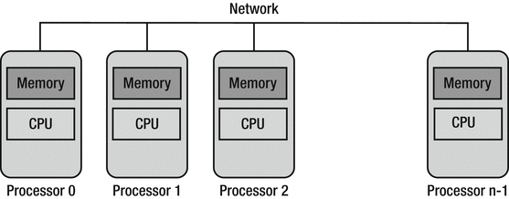
INTRODUCTION
- Message Passing Interface (MPI) is a standardized and portable message-passing system developed for distributed and parallel computing.
- MPI provides parallel hardware vendors with a clearly defined base set of routines that can be efficiently implemented
WHAT IS MPI?

Slide 7

2. ANALYSIS
- At least three processes:
+ 1 for server
+ 2 for clients
- Two ports for two clients
- COMM_WORLD, COMM_SELF
- Advantages:
+ Simplicity
+ Performance
+ Generality
+ Scalability

Slide 8
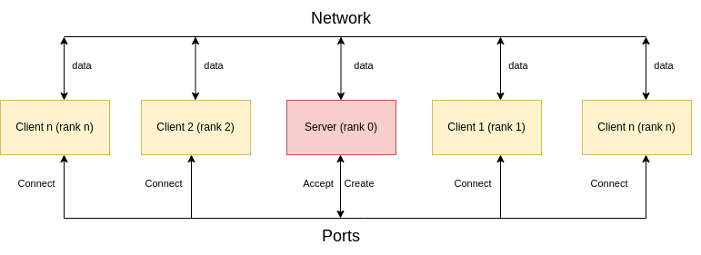
3. DESIGN

Slide 9
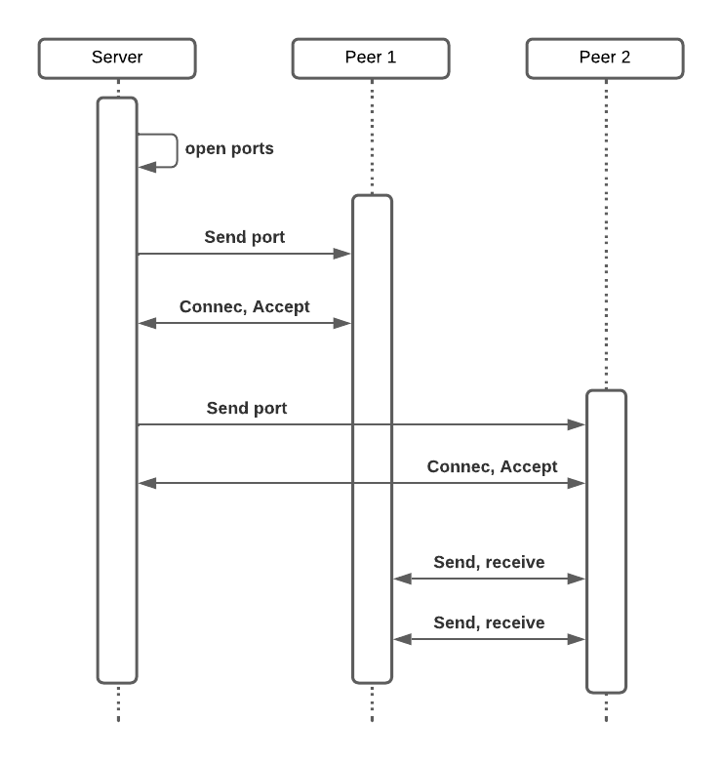
4. METHODS
- Using mpi4py to import MPI for Python to create 2 Communicators with 2 ports
- Server serves multiple peers:
+ Multi-threading
+ Blocking
- Communication type:
+ Point-to-Point

Slide 10

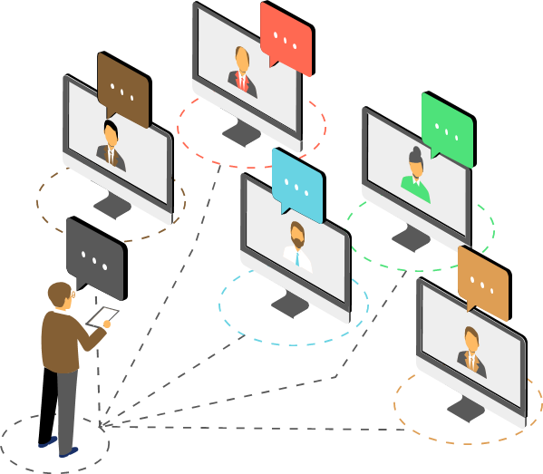
5. CONCLUSION
- We have done:
+ P2P system
+ Research for MPI
+ The interesting MPI issues that is surprise for participants. This project has focused on some of these interesting and difficult issues, but in most cases, programming in MPI is similar to programming in other message-passing interfaces but we need to take time to research more about it.

Slide 11
5. CONCLUSION
- We have not done:
+ Live chat
+ User authentication (maybe)
+ Database

Slide 12
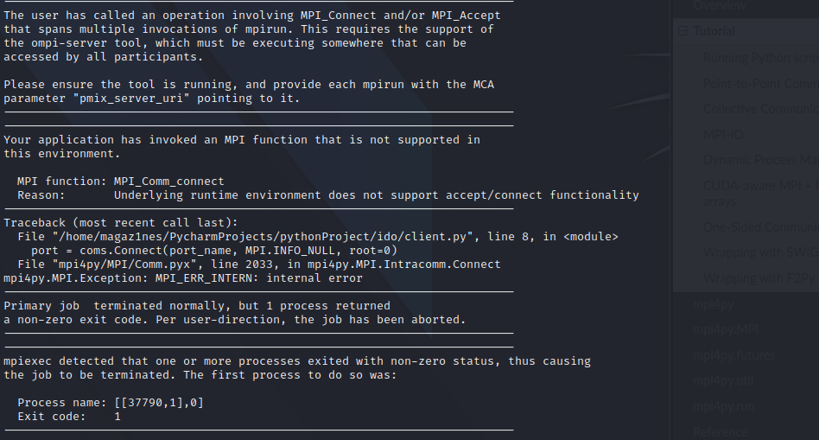
5. CONCLUSION
- Difficulty
+ Multiple invocations of mpirun problem

Slide 13
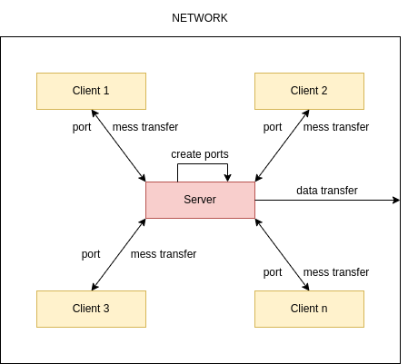
5. CONCLUSION
- Future work:
+ Finish Live chat
+ Do user authentication (maybe)
+ Do Database

Slide 14


